Slide 1


CS 517/MIS 517
Database Design and Management
Fall 2015
Final Project
Ticketing Management System
Rajeswar Reddy Veeraballi s1018686@monmouth.edu
1

Slide 2
Project Description
A school issues(problems) Ticketing Management database system
•
•
Web and Mobile based application Ticketing management System
Tracks issue ticket, and the tickets can be reassigned, closed and the issue activity can be tracked
•

Slide 3
Ticketing Issues Model Objects
•
Departments – Technical, Electrical, Interior, Gardening
•
Issue Types – computers, Internet etc;
•
Issue Activity log to track Issue Tickets

Slide 4
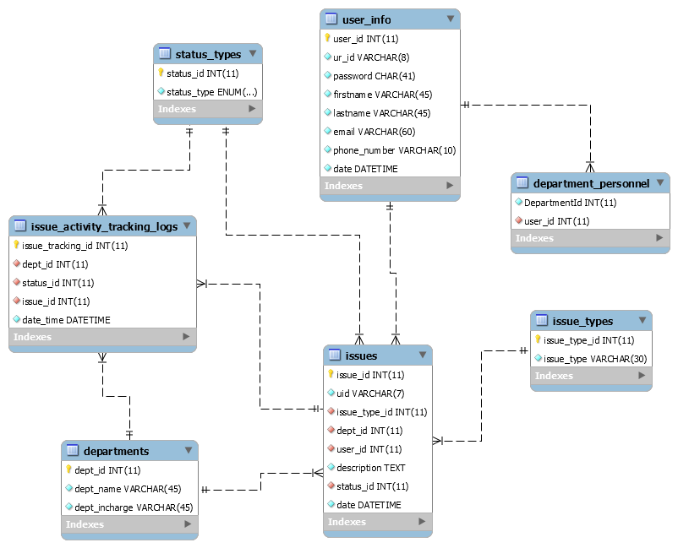
ER Diagram

Slide 5
Ticketing System Database
•
7 Tables, normalized
•
Primary and foreign key constraints
•
Additional keys for query optimization
•
date, department id, issues
•
Stored Procedures for all database interaction

Slide 6
DB Implementation
•
Stored Procedures for all DB interaction
•
7 procedures – 2 with Transaction protection and Exception Handling
•
View for issue activity info
•
Triggers for inserting and updating Issues log
•
Function for checking user existence

Slide 7
Portal Implementation
•
Web and Mobile compatible application
•
Has multiple screens to Login(user and admin) Registration etc
Developed using .net (asp.net, bootstrap and ado.net for connecting database) - dbo for database access
•
•
Mobile compatibility by using bootstrap
•
5 screens - Login validation, Registration, Create Ticket, My tickets, Track issue activity

Slide 8
D E M O

